Slide 1


Project Plan
Build. Share. Earn. Learn

Slide 2
About the Project
Risks
Agenda
Scope
stakeholder communication
Overview of today's presentation
Role Assignment
Budget
Timeline
Resources

Slide 3
Meet the Team
AIMEN MUNAWAR
AIMA SIBTAIN
MAHEEN AKHTAR KHAN
HADIA ALI
HASNAIN ALI
SARMAD MAJEED ABASSI

Slide 4
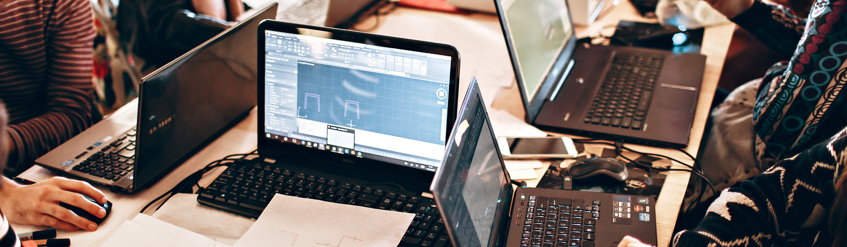
Project Overview
ProjectX is a digital marketplace for university students to buy and sell completed academic projects. It aims to monetize student work, promote knowledge sharing, and offer a secure, efficient user experience.
Academic Project Marketplace

Slide 5
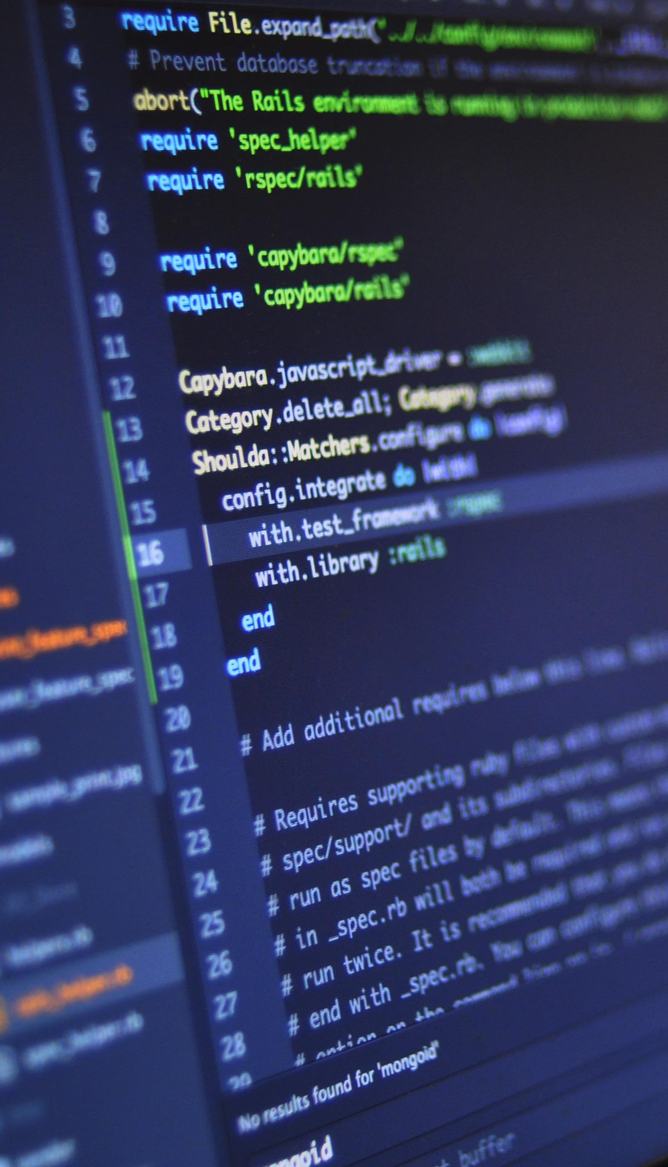
Core Features
User Authentication (login/signup)
Project Listings (categorized by domain, price, etc.)
Search & Filters (by keywords, ratings, price)
Secure Checkout & Order Tracking
Admin Panel for analytics
Learning Resources (tutorials & guides)

Slide 6









Tech Stack

Slide 7


Digital project marketplace only
Scope of
the Project
No freelancing or physical product delivery
What "Project X" Covers
No plagiarism checks or multi-language support

Slide 8





Hierarchy
Aimen Munawar - PM
Maheen Khan - Backend Dev
Sarmad Abassi - UI/UX
Hadia Ali, Aima Sibtain - Frontend Dev
Hasnain Ali - QA

Slide 9
Key Responsibilities
Member | Role | Primary Focus | Example
Aimen Munawar | Project Manager & Backend Support | Planning, coordination, stakeholder comms | Progress tracking through Slack
Maheen Khan | Backend Developer | APIs, DB design, server setup, deployment | Schema & REST API design
Hadia Ali | Frontend Developer | Auth flows, listings/dashboard UI | React components design using Tailwind
Aima Sibtain | Frontend Developer | Cart, admin panel, checkout UI | React components design using Tailwind
Sarmad Majeed Abbasi | UI/UX Designer | Wireframes, hi-fi prototypes | Creating hi-fi prototypes on Figma
Hasnain Ali | QA Tester | Test cases, unit & integration tests, UAT | Unit/Integration testing using Jest

Slide 10

Project Timeline
Gantt Chart
https://miro.com/app/board/uXjVI8NspTw=/

Slide 11




Project Risks
Technical Delays
Copyright Infringement
or IP Violations
Quality Control Issues

Slide 12
Primary (Mam Ayesha Maqbool)
Stakeholders
Internal Team
External (Student, buyers)

Slide 13
Stakeholders Communication
Audience | Purpose | Tool | Frequency | Responsibility
Internal Team | Coordination of tasks | Slack | Daily | Aimen (PM)
Internal Team | Task tracking | Linear | Daily/Weekly | Aimen (PM)
Internal Team | Meetings | Google Meet | Daily/Biweekly | Aimen (PM)
Internal Team | File sharing & collaboration | Google Drive, Github | As needed | Aimen (PM)
End-Users | Feedback on product | Google Forms, Slack | As needed | Sarmad, Aimen
End-Users | Marketing & engagement | Social Media | As needed | Sarmad, Aimen
Mam Ayesha Maqbool | Approving deliverables | LMS | Submission basis | Aimen (PM)

Slide 14

Project Resources - Budget
Human Resource
Technical Tools/Softwares
Hardware/ Infrastructre
RESOURCE | TOTAL COST | % OF BUDGET
Human Resource | 682,500 | 81.29%
Tools / Softwares | - | -
Infrastructure | 157,075 | 18.71%
Total | 839,575 | 100%

Slide 15
Budget Control Measures
Monitoring Strategies
Cost Control Strategies
Weekly Cost Tracking
Cost Threshold and Approvals
Real Time Expense Logging
Prioritization of Free Tools
Stakeholder Reporting
Variable Cost Optimization
Risk-Based Cost Control

Slide 16
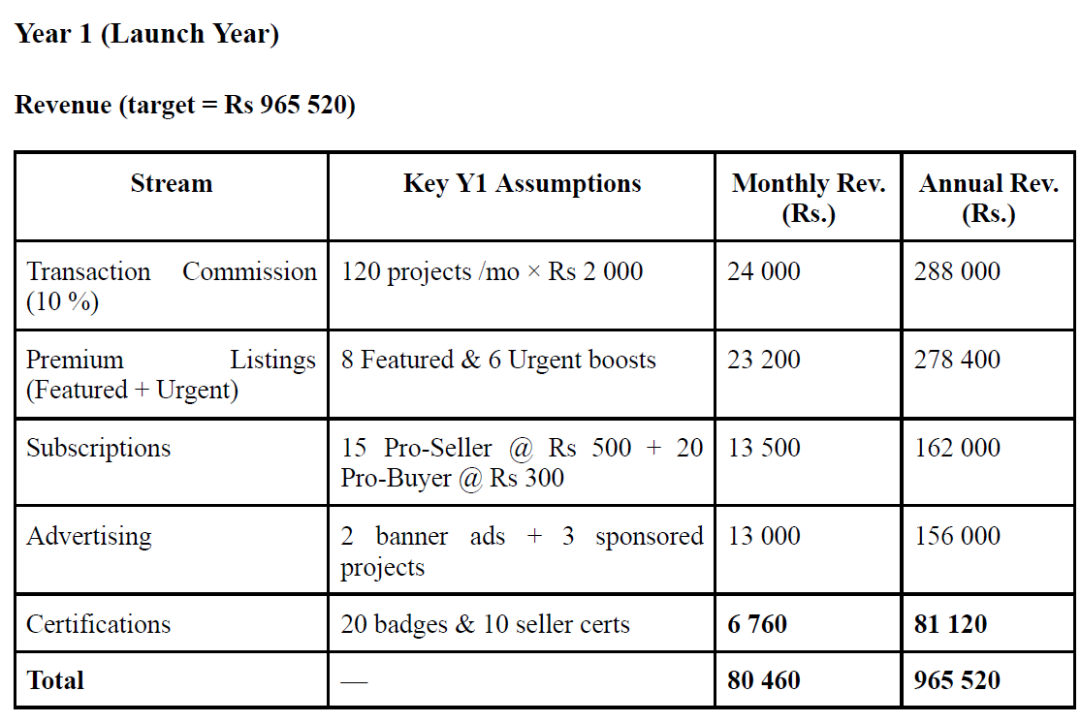
Revenue Model

Slide 17
Thank you!

